Slide 1
BMS III SEMESTER
University Examination 75 Marks
Descriptive 60; Case 15
Internal Assessment 50 Marks
25 Marks
Total 100 Marks
Objectives:
To equip the students with management policies and strategies at entry level to develop conceptual skills in this area as well as application in corporate world

Slide 2
Unit I
1. Business Policy – Meaning, Nature, Importance, Case studies
2. Strategy – Meaning, Definition
3. Strategic Management- Meaning, Defination, Importance of Strategic Management
4. Process & Levels of strategy and concept and Importance of SBU’s
5. Strategic Intent - Mission, Vision, Goals, Objective, Plans

Slide 3
BUSINESS POLICY what exactly it is?
Business Policy defines the scope or spheres within which decisions can be
taken by the subordinates in an organization.
It permits the lower level management to deal with the problems and issues
without consulting top level management every time for decisions.
Business policies are the guidelines developed by an organization to govern its
actions.
They define the limits within which decisions must be made.
Business policy also deals with acquisition of resources with which organizational goals
can be achieved.
It is the study of the roles and responsibilities of top level management, the significant issues
affecting organizational success and the decisions affecting organization in long-run.

Slide 4
FEATURES OF BUSINESS POLICY
Specific- Policy should be specific/definite. If it is uncertain, then the implementation will become difficult.
Clear- Policy must be unambiguous. It should avoid use of jargons and connotations. There should be no misunderstandings in following the policy.
Reliable/Uniform- Policy must be uniform enough so that it can be efficiently followed by the subordinates.
Appropriate- Policy should be appropriate to the present organizational goal.
Simple- A policy should be simple and easily understood by all in the organization.
Inclusive/Comprehensive- In order to have a wide scope, a policy must be comprehensive.
Flexible- Policy should be flexible in operation/application. This does not imply that a policy should be altered always, but it should be wide in scope so as to ensure that the line managers use them in repetitive/routine scenarios.
Stable- Policy should be stable else it will lead to indecisiveness and uncertainty in minds of those who look into it for guidance.

Slide 5
FACTORS DETERMINING BUSINESS POLICY
INTERNAL FACTORS.
  Business Mission
  Business Objectives
  The resources
  Management philosophy & Values
  EXTERNAL FACTORS
    Industry Structure
    Economic Environment
    Political Environment
    Social Environment
    Technology

Slide 6
IMPORTANCE OF BUSINESS POLICY
Aid in decision making
Aid in communication
Ensures Better Coordination
Facilitates Utilization of resources
Facilitates Planning.
Facilitates control
Motivates Employees
Enhances corporate Image
Encourages Initiative
Facilitates Performance Appraisal
Provides Stability

Slide 7
Difference between Policy and Strategy
The term “policy” should not be considered as synonymous to the term
Strategy
Policy is a blueprint of the organizational activities which are repetitive/routine in nature. While strategy is concerned with those organizational decisions which have not been dealt/faced before in same form.
Policy formulation is responsibility of top level management. While strategy formulation is basically done by middle level management.
Policy deals with routine/daily activities essential for effective and efficient running of an organization. While strategy deals with strategic decisions.
Policy is concerned with both thought and actions. While strategy is concerned mostly with action.
A policy is what is, or what is not done. While a strategy is the methodology used to achieve a target as prescribed by a policy.

Slide 8
Concept of Corporate Strategy
“ Strategy is a broad long-term plan designed to achieve the overall objectives of the firm”
“ Strategy is a unified comprehensive and integrated plan designed to ensure that the basic objectives of the enterprise are achieved”
Strategy is used in business to describe how an organisation is going to achieve its overall objectives.
Strategy is a comprehensive long term plan. It tries to answer three main questions:
What is the present position of firm?
What should be the future position of the firm?
What should be done to attain the future position?

Slide 9
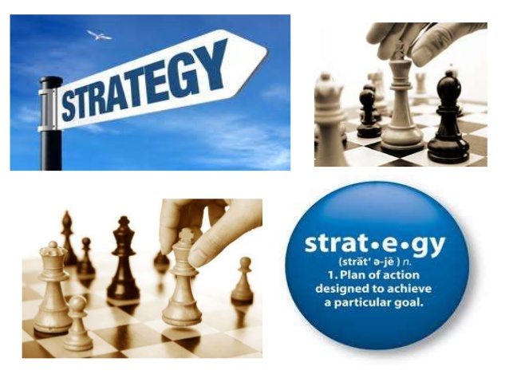

Slide 10
NATURE & CHARACTERISTICS OF sTRATEGIES
Objectives oriented
Future Oriented
Unified, comprehensive & Integrated
Strategy alternatives.
Relates to the environment
Allocation of Resources
Universal applicability
Periodic Review
Applicable to all functional areas
Strategy as process

Slide 11
STRATEGIC MANAGEMENT PROCESS
Environmental scanning
Strategy Formulation
Strategy Implementation
Strategy Evalaution

Slide 12

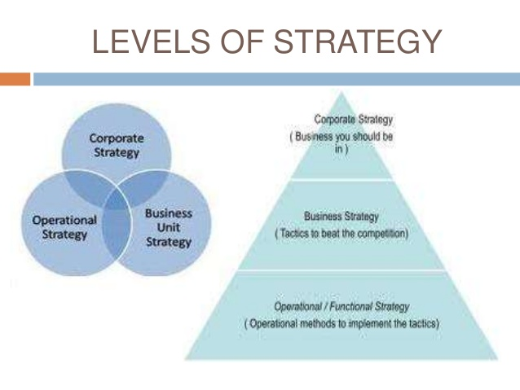
LEVELS OF STRATEGY
At the corporate level, you are responsible for creating value through your businesses. You do so by managing your portfolio of businesses, ensuring that your businesses are successful over the long term, developing business units, and sometimes ensuring that each business is compatible with others in your portfolio.

Slide 13
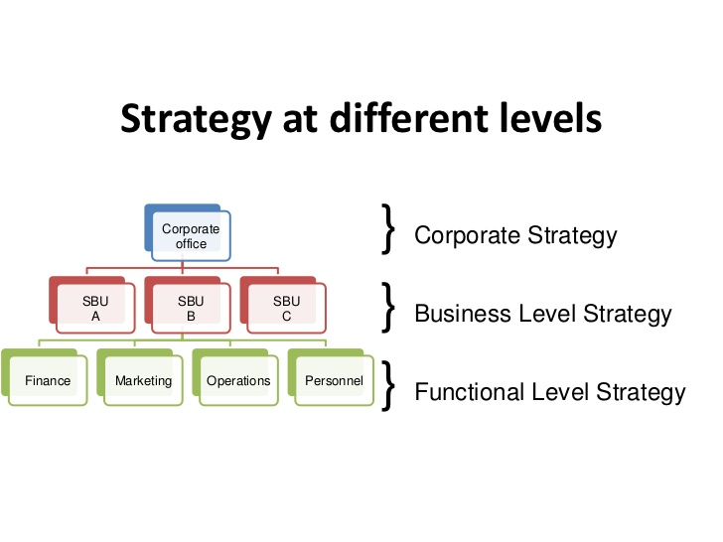
STRATEGY AT DIFFERENT LEVELS

Slide 14
CORPORATE LEVEL STRATEGY
Defining what business the company is in setting the overall structure, systems and processes
Corporate level strategy fundamentally is concerned with selection of businesses in
which your company should compete and with development and coordination of that
portfolio of businesses.
Corporate level strategy is concerned with:
Reach
Competitive Contact.
Managing Activities & Business Interrelationships.
Management Practices
Example : Coco cola, Inc., has followed the growth strategy by acquisition. It has acquired local bottling units to emerge as the market leader.

Slide 15
BUSINESS LEVEL STRATEGY
Deciding how to compete Identifying competitive advantage, Selecting key success Factors
Business level strategies are intended to create differences between the firms position relative to those of its rivals.
To position itself, the firm must decide whether it intends to perform activities differently or to perform different activities as compared to its rivals.
Customers are the foundation or essence of a organization's business-level strategies. Who will be served, what needs have to be met, and how those needs will be satisfied are determined by the senior management.
Who are the customers?
Demographic, geographic, lifestyle choices (tastes and values), personality traits, consumption patterns (usage rate and brand loyalty), industry characteristics, and organizational size.
What are the goods and/or services that potential customers need?
Knowing ones customers is very import in obtaining and sustaining a competitive advantage. Being able to successfully predict and satisfy future customer needs is important. (Perhaps one of Compaq's mistakes was not understanding who their real customer was and what that customer -- end user -- wanted.)
How to satisfy customer needs?
Organizations must determine how to bundle resources and capabilities to form core competencies and then use these core competencies to satisfy customer needs by implementing value-crating strategies.
Example : Apple Computers uses a differentiation competitive strategy that emphasizes innovative product with creative design

Slide 16

FUNCTIONAL LEVEL STRATEGY
Functional level strategy executes the plan developed at a higher level for the growth and advancement of an organization.
Functional strategies are primarily concerned with:
Efficiently utilizing specialists within the functional area.
Integrating activities within the functional area (e.g., coordinating advertising, promotion, and marketing research in marketing; or purchasing, inventory control, and shipping in production/operations).
Assuring that functional strategies mesh with business-level strategies and the overall corporate-level strategy.
Production strategy( "make or buy") - defines what the company produces itself, and that purchases from suppliers or partners, that is, how far worked out the production chain.
Financial Strategy- to select the main source of funding: the development of their own funds (depreciation, profit, the issue of shares, etc.) or through debt financing (bank loans, bonds, commodity suppliers' credits, etc.).
Example, Procter and Gamble spends huge amounts on advertising to create customer demand.

Slide 17
STRATEGIC BUSINESS UNIT
An SBU is a semi-autonomous unit that is usually responsible for its own budgeting, new product decisions, hiring decisions, and price setting.
Factors that determine the success of an SBU include the degree of autonomy given to each SBU manager, the degree to which an SBU shares functional programs and facilities with other SBUs, and the manner in which the corporation adopts to new changes in the market.
An SBU may be a business unit within a larger corporation or it may be a business unto itself. Corporations may be composed of multiple SBUs, each of which is responsible for its own profitability.
According to Kotler- An SBU is “a unit of company that has a separate mission, and objectives and that can be planned independently from other company business”
It is a single business or collection of related businesses
It has its own competitors
It has a manager who is accountable for its operation
It is an area that can be independently planned for within the organization
Bharat College (Strategic Management)\Axis Bank recasts business into four strategic units - timesofindia-economictimes.html

Slide 18
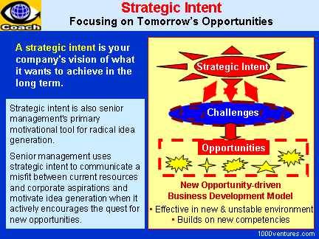
STRATEGIC INTENT- "Everything depends upon execution; having just a vision is no solution."
– Stephen Sondheim
High-level statement as a means to achieve the vision of the company
It’s a companies vision of what it wants to achieve in the long term.

Slide 19

MISSION, VISION & GOALS
MISSION STATEMENT:
This brief statement declares the purpose of an organization and defines the reason for the company's existence.
It provides the framework and context to help guide the company's strategies and actions by spelling out the business's overall goal.
Helps guide decision-making internally while also articulating the company's mission to customers, suppliers and the community.
The mission statement is also not necessarily the same as your vision statement,

Slide 20
What does a mission statement include
A good mission statement answers several key
questions about your business:
What are the opportunities or needs that the company addresses?
What is the business of the organization? How are these needs being addressed?
What level of service is provided?
What principles or beliefs guide the organization?

Slide 21

VISION
TATA POWER VISION, MISSION & VALUES
Vision statement can help you communicate your company's goals to employees and management in a single sentence.
They lay out the most important primary goals for a company.
Vision statements generally don't outline a plan to achieve those goals. But by outlining the key objectives for a company, they enable the company's employees to develop business strategies to achieve the stated goals.

Slide 22
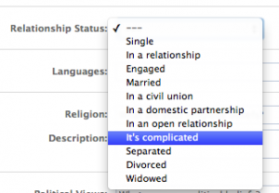
VISION STATEMENT

Slide 23
DEFINING ORGANISATIONAL GOALS & OBJECTIVES
Involves breaking up of a mission statement into definite milestones, identifying events activities, and plotting the stages and targets to a series of goals in a time-bound manner.
Goals must be linked to corporate performance parameters such as profitability, liquidity, growth, productivity & sustainability.
Goals should be precise & measurable.
Care should be taken to ensure that they can be easily related by all stakeholders

